Slide 1
NBKR INSTITUTE OF SCIENCE AND TECHNOLOGY
PROJECT TITLE: MOVIE TICKET BOOKING
BRANCH:CSE
SECTION:C
DATE:01 MARCH
Submitted to Ashok Selva Kumar E
Submitted By:
Name: J.Uma Mahesh Teja(24KB1A05M3)
K.Vamsi Krishna (24KB1AO5R4)
K.Nithin Kumar(24KB1A05S3)
G.Chaithanya(24KB1A05K3)

Slide 2

Introduction:
User can select a movie, showtime, and seat.
Confirms booking and shows ticket details.Booking history is stored in a file.
Uses arrays, structures, functions, and file handling in C.
Simple, menu-driven interface for easy use.

Slide 3

Objective: To develop a simple and efficient C program that allows users to book movie tickets by selecting a movie, showtime, and seat, while maintaining a record of all bookings using file handling.

Slide 4

Key Functions: showMovies() – displays available movies showShowtimes() – displays showtimes for a selected movie bookTicket() – handles booking and saves it to file viewBookingHistory() – reads and displays from file Sample Booking Flow: 1. User selects a movie 2. User selects a showtime 3. User enters seat number 4. Booking is confirmed 5. Data is saved to booking_history.txtSlide File Handling: Uses fopen, fprintf, and fgetc to: Append booking records Read past bookings Simple text file storage for portability

Slide 5

Key Features of the Program:
*Displays a list of available movies and showtimes.
*Allows seat selection and checks seat availability.
*Confirms ticket booking with movie, time, seat details.
*Saves all bookings into a file for history tracking.
*Handles multiple bookings in one run.

Slide 6
Source Code: https://onlinegdb.com/DnWp_yPBE

Slide 7
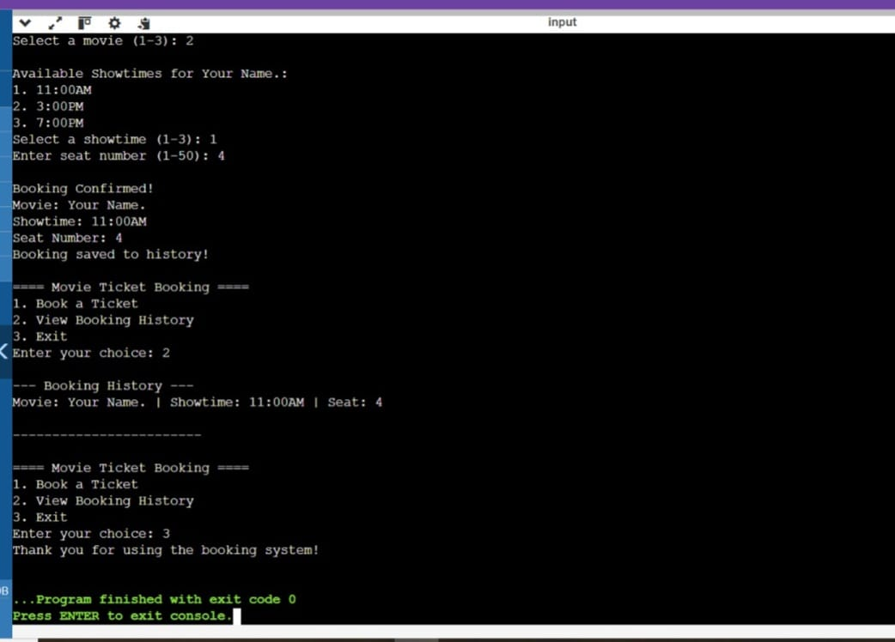
Output :

Slide 8

Conclusion: This project is a simple movie ticket booking system made in C. It uses structures and file handling to book tickets and save history. It is easy to use and can be improved further with more features like seat tracking and dynamic movie lists.

Slide 9


